Slide 1

Notes:
Do you know the feeling, when ….
You open the fridge and you have no clue what to cook with the available ingredients?
You are not even sure how they got there?

Slide 2
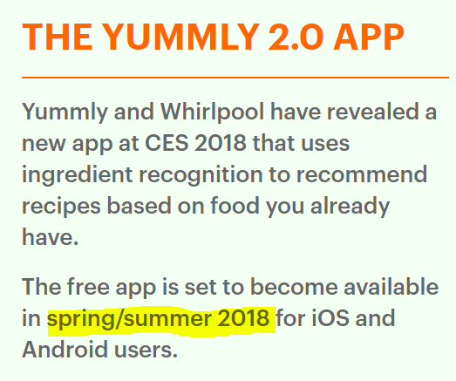
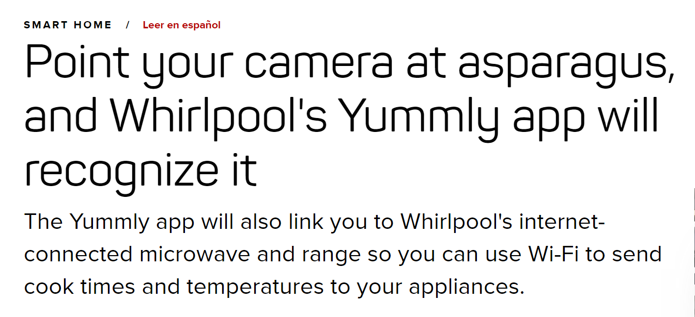
Notes:
An App Promised the solution.
Yummly 2.0
But Yummly did not deliver until today. And we don’t like asparagus anyways.

Slide 3






3.0
Don’t know what to cook? No clue what the food in your fridge is called?
We’ve got you!
Notes:
This is why we developed Yummly3.0.
Beautifully engineered python front end

Slide 4




Functionality
Get Ingredients
Manage Your Account
Get Recipes
Manage Recipes in Database
1
2
3
sign up, login, delete or change
by picture or by natural language
save and get all your recipes

Slide 5
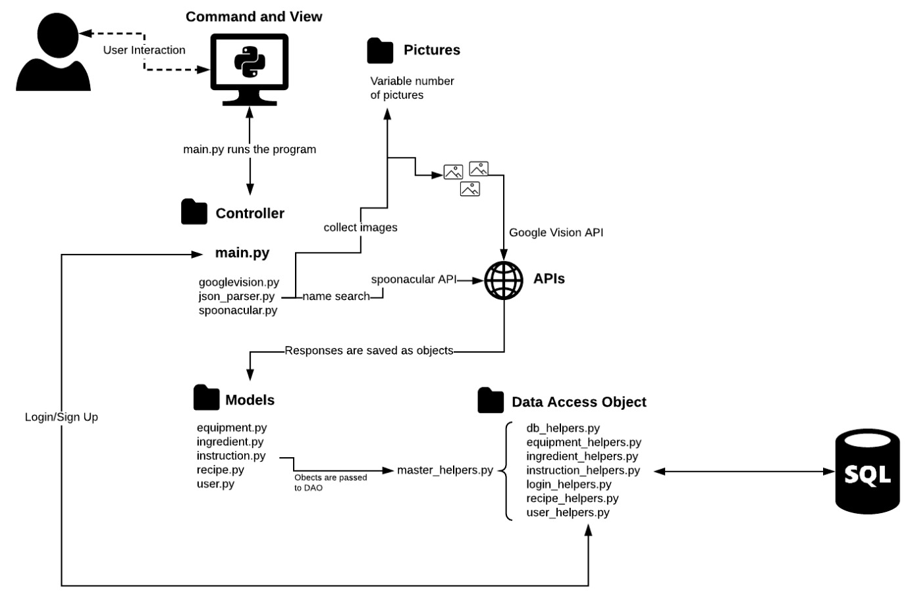
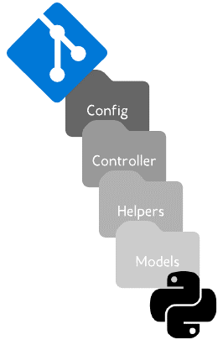
File Structure

Slide 6
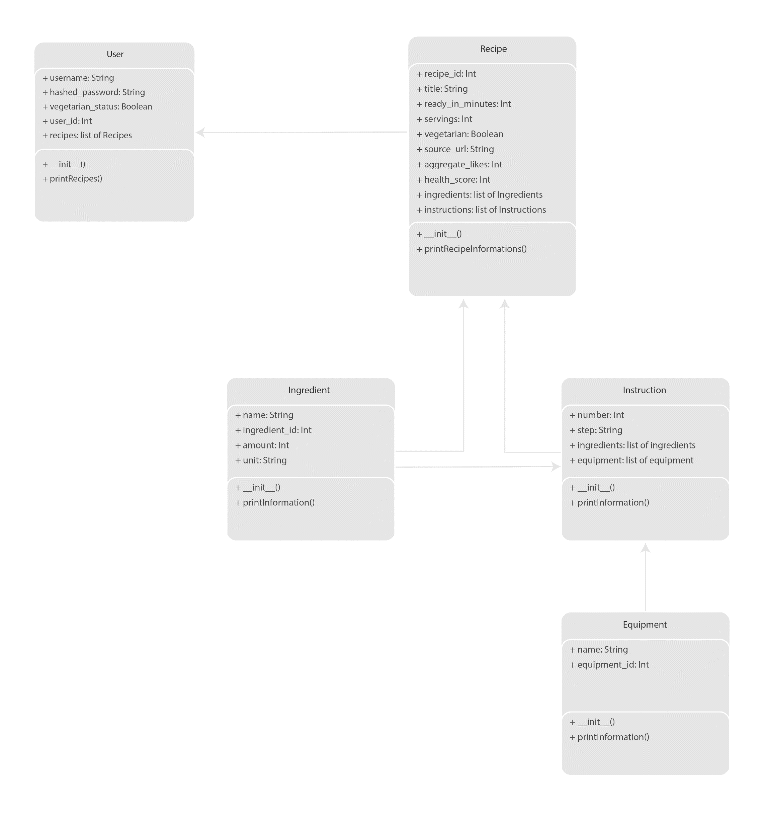
Class Structure

Slide 7
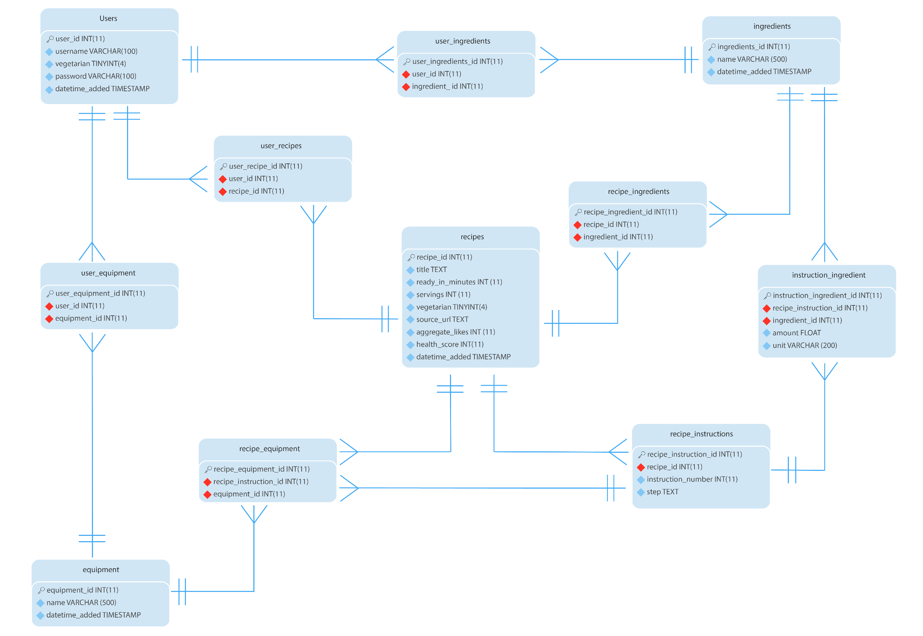
Database

Slide 8
Critical Discussion

Slide 9













Further Development
Recipe Search
Missing/Leftover
Ingredients
Nutritional Habits
Ingredients
User Profiles
Health
Score

Slide 10





Business Application

Slide 11
A-SERIES FUNDING
Notes:
Series A funding is useful in optimizing product and user base.

